Slide 1
Mod 02 - Python Lists and Advanced Flow Control
Scripting Essentials
Dr. Burkman

Slide 2
Learning Objectives
Understanding Python lists
indexes
slices
length
changing values
concatenating and replicating lists
deleting values
looping through lists
Checking if a value is in (or not in) a list
list methods
index
append
insert
remove
sorting a list
mutability
tuples
converting tuples and lists
list references
copying a list (deepcopy)

Slide 3
Learning Objectives
Functions
Variable Scope
Exception Handling

Slide 4
Lists
Basics:
A list contains multiple values in an ordered sequence.
Items are the things inside a list
Lists are inside square brackets [ ]
Item are comma delimited
Examples:
[1, 2, 3]
[‘cat’, ‘rat’, ‘bat’]
[1, ‘Bob’, 3.14]

Slide 5
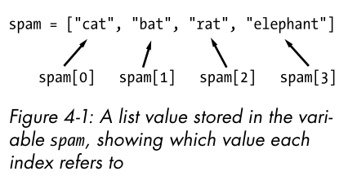
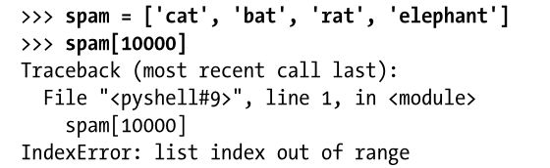
List Indexes
Items in a list are access by integer position, left to right, starting with zero
Index out of range error:

Slide 6
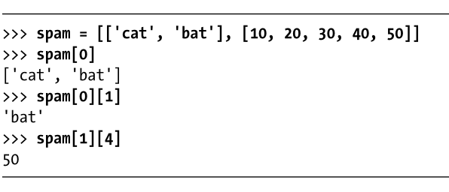
List Indexes
Lists can contain lists:
Note how you access items in a list, in a list
spam = [['cat', 'bat'], [10, 20, 30, 40, 50]]
print (spam[0])
print (spam[0][1])
print (spam[1][4])

Slide 7
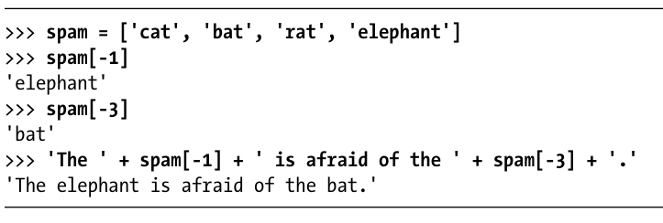
List Indexes
You can use negative indexes
They reference right to left
spam = ['cat', 'bat', 'rat', 'elephant']
print (spam[-1])
print (spam[-3])
print ('The ' + spam[-1] + ' is afraid of the ' + spam[-3] + '.')

Slide 8
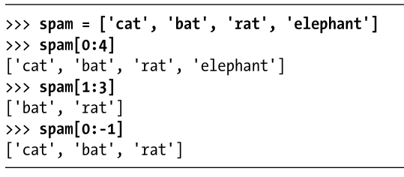
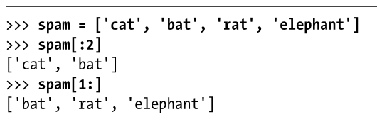

List Indexes
Slices get several values from a list
List[start:end]
The end value is never included
Or you can leave out one end:
spam = ['cat', 'bat', 'rat', 'elephant']
print (spam[0:4])
print (spam[1:3])
print (spam[0:-1])
print (spam[:2])
print (spam[1:])
print (spam[:])

Slide 9
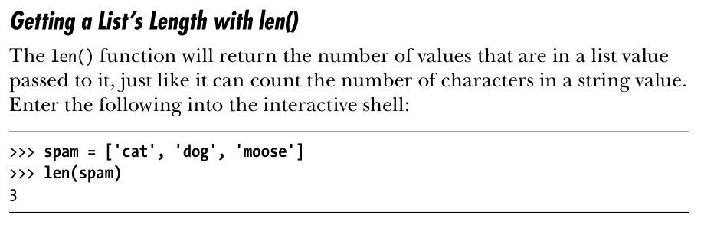
List Length
spam = ['cat', 'dog', 'moose']
print (len(spam))

Slide 10
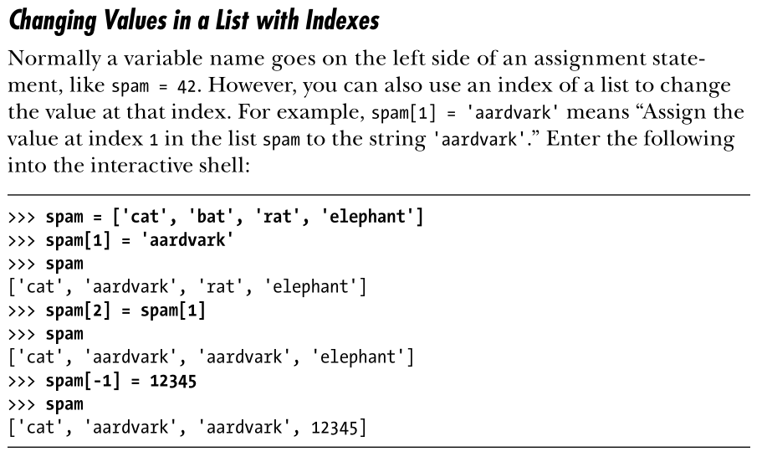
Changing List Values
spam = ['cat', 'bat', 'rat', 'elephant']
spam[1] = 'aardvark'
print(spam)
spam[2] = spam[1]
print (spam)
spam[-1] = 12345
print (spam)

Slide 11
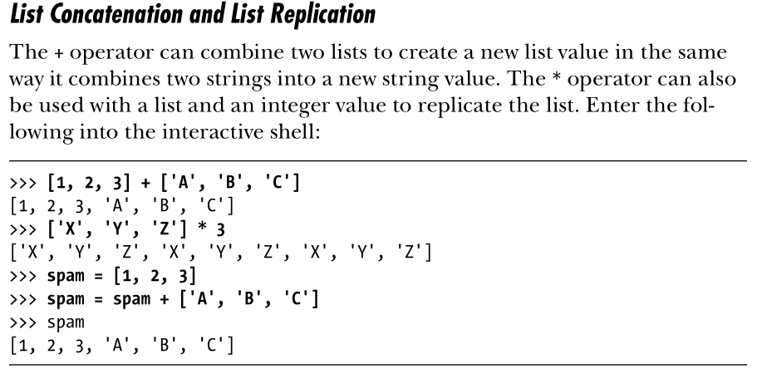
List Concatenation and Replication

Slide 12
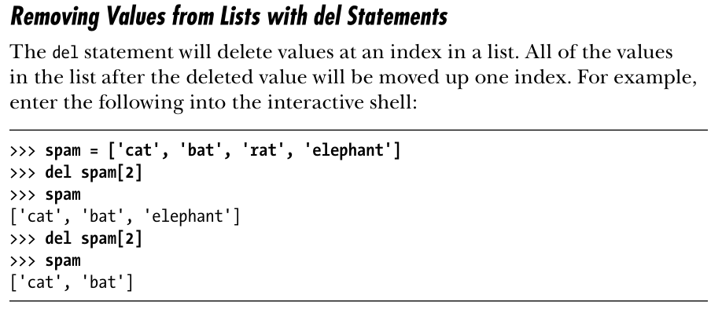
Removing Values with del
spam = ['cat', 'bat', 'rat', 'elephant']
del spam[2]
print(spam)
del spam[2]
print(spam)

Slide 13
Example Usage (Try this)
cat_names = [] #I am initializing an empty list
while True:
print('Enter the name of cat ' + str(len(cat_names) +1) +
' (Or enter nothing to stop.):')
name = input()
if name == '':
break
cat_names = cat_names + [name] #list concatenation
print('The cat names are:')
for name in cat_names:
print(' ' + name)

Slide 14
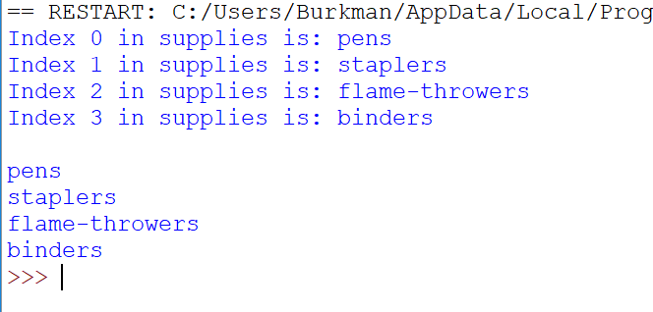
Looping Lists
supplies = ['pens', 'staplers', 'flame-throwers', 'binders']
for i in range(len(supplies)):
print('Index ' + str(i) + ' in supplies is: ' + supplies[i])
print()
for j in supplies:
print(j)
Note: len(supplies) = 4
Instead of using For to iterate through a range, we are iterating through a collection.

Slide 15
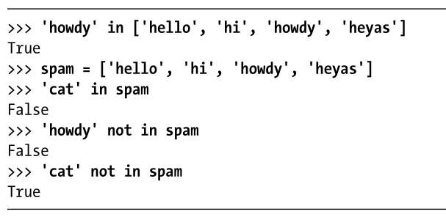
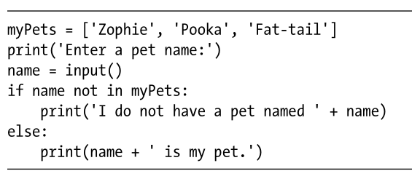
Is X in my list?
In and Not in yield a Boolean evaluation:

Slide 16
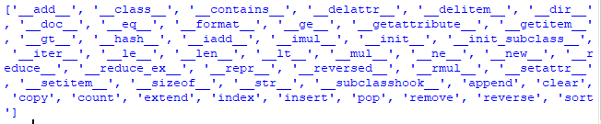
Methods
Same as a function but it is called on a value. Data types have methods.
Method comes after value, separated by a period.
Remember, we can find the methods with dir
dir(list)

Slide 17
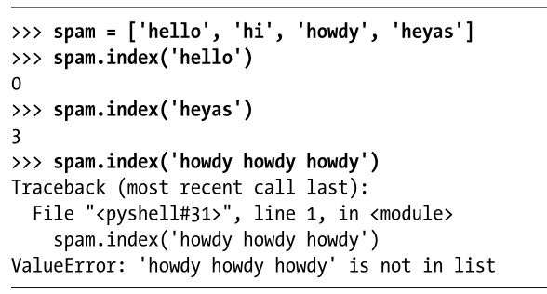
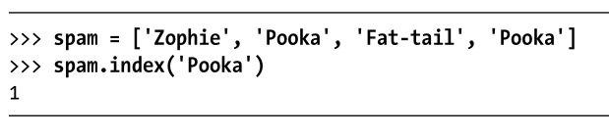
list.index
Note: If duplicates are in a list, index only finds the first instance

Slide 18

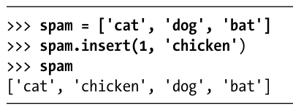

list.append and list.insert
list.append
list.insert

Slide 19
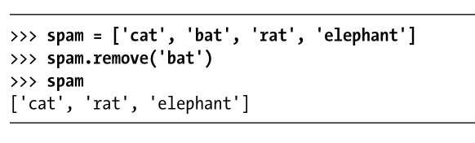
list.remove

Slide 20
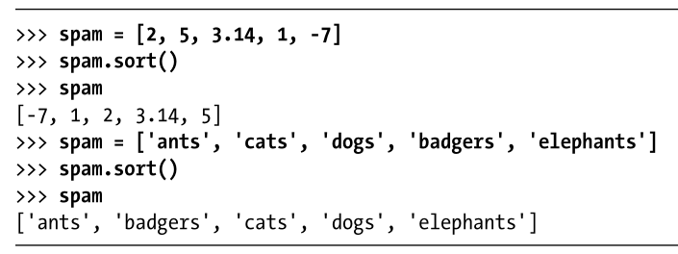
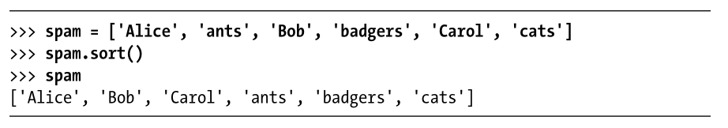
Sorting a list
The sort method can only sort:
like things (no mixing numbers and strings)
ASCII style
A a B b

Slide 21
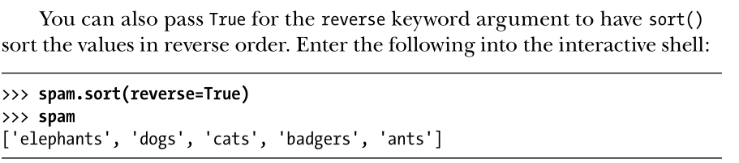
Sorting a list

Slide 22
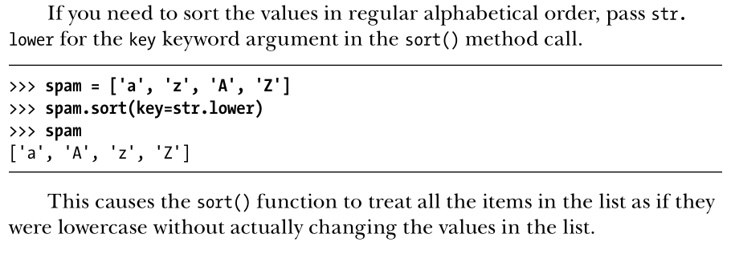
Sorting a list
You can also sort using the key keyword argument:

Slide 23
Try This
import random
messages = ['It is certain',
'It is decidedly so',
'Yes definitely',
'Reply hazy try again',
'Ask again later',
'Concentrate and ask again',
'My reply is no',
'Outlook not so good',
'Very doubtful']
print(messages[random.randint(0, len(messages) - 1)])

Slide 24
A Slight Change
import random
a=0
while a<5:
messages = ['It is certain',
'It is decidedly so',
'Yes definitely',
'Reply hazy try again',
'Ask again later',
'Concentrate and ask again',
'My reply is no',
'Outlook not so good',
'Very doubtful']
print(messages[random.randint(0, len(messages) - 1)])
a = a +1

Slide 25
Mutability
Mutable
Can have values added, removed or changed
Lists are mutable
Immutable
Cannot be changed
Strings and tuples are immutable

Slide 26
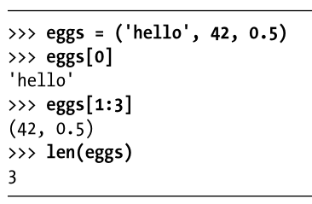
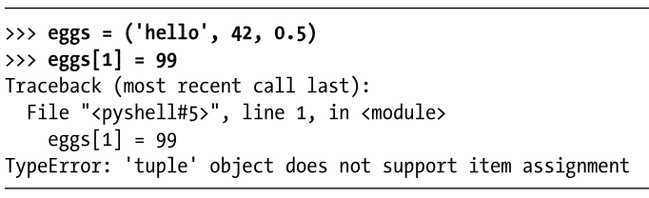
Tuple
A tuple acts like an immutable list
Has parentheses instead of square brackets.

Slide 27
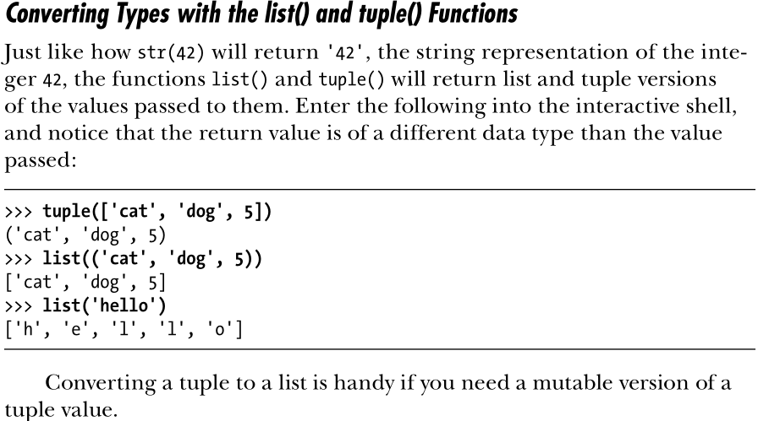
Converting Types

Slide 28
Populating a List with a Range
In Python 3 range is an iterator so you have to convert it to a list.
Note that the upper value isn’t included
my_list = list(range(1, 1001))
print(my_list)

Slide 29
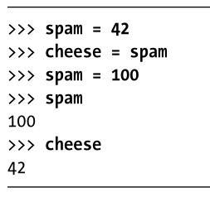
Understanding List References
Variables work like we’d expect. Each variable is its own “container”, even if it gets “filled” by another variable.

Slide 30
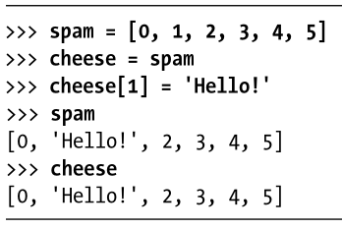
Understanding List References
Lists don’t work this way. When you assign a list to a variable, the variable is only storing a reference (like a pointer) to that list. There are never multiple instances of one particular list.
Here, cheese is just pointing to the original spam list. Changes made to cheese actually go right over to the original spam list.

Slide 31
Copying a list with copy()
import copy
spam = ['A', 'B', 'C', 'D']
cheese = copy.copy(spam) #This does make a new list
cheese[1] = 42
print(spam)
print(cheese)

Slide 32
Copy.deepcopy
#Use deepcopy() if your list contains lists
import copy
spam = [[1,2,3],['a', 'b', 'c']]
cheese = copy.deepcopy(spam) #This does make a new list
cheese[0][1] = 42
print(spam)
print(cheese)

Slide 33
Functions
A named chunk of code that may, or may not, accept parameters. The parameter value only exists while the function runs (“name”, in the second example).
def hello():
print('Hello World')
hello()
def hello(name):
print('Hello ' + name)
hello('Jim')
hello('Nita')

Slide 34
Functions
import random
def getAnswer(answerNumber):
if answerNumber == 1:
return 'It is certain'
elif answerNumber == 2:
return 'It is decidedly so'
elif answerNumber == 3:
return 'Yes'
elif answerNumber == 4:
return 'Reply hazy try again'
elif answerNumber == 5:
return 'Ask again later'
elif answerNumber == 6:
return 'Concentrate and ask again'
elif answerNumber == 7:
return 'My reply is no'
elif answerNumber == 8:
return 'Outlook not so good'
elif answerNumber == 9:
return 'Very doubtful'
r = random.randint(1, 9)
fortune = getAnswer(r)
print(fortune)
Return does just that, it returns a value from a function
Here r is assigned a random value, then that value is passed to the getAnswer function. The return value gets assigned to “fortune”, which is then printed.

Slide 35
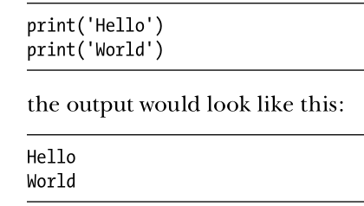
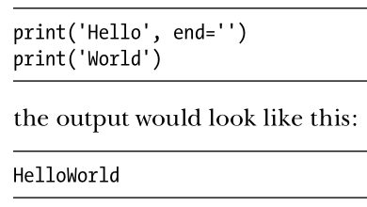
Keyword Arguments in Built-in Functions
Generally the order of function inputs matters
random.randint(1, 10) take the lower and upper bounds. It is not the same as random.randint(10, 1)
Keyword arguments are used for optional parameters
Here the “end” parameter changes the newline to the specified delimiter ‘’.

Slide 36
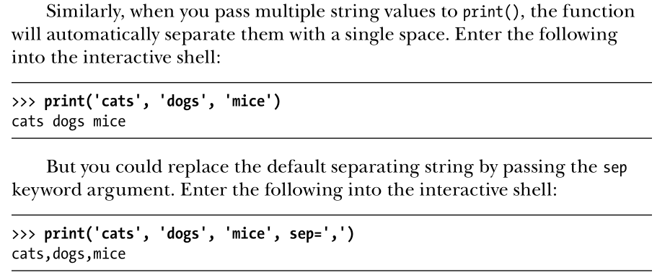
Keyword Arguments in Built-in Functions

Slide 37
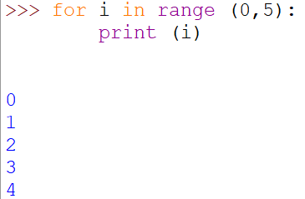

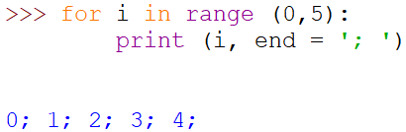
Sep vs End
By default the end parameter in Print is a new line. End changes that, so if you have multiple print statements (or a print statement that runs multiple times in a loop) you can get the output items together with something like end = ‘ ‘
Sep provides the character(s) between items being printed. The default is a space (technically a soft space)

Slide 38
Scope
Scope is like a container for all your variables
Global scope is created when your program begins, and destroyed when the program ends
There’s only one global scope
Local scope is created whenever a function is called, and destroyed when the function ends.
There can be many local scopes
Access rights:
Global cannot access local
Local cannot access other local
Local can access Global
Variable names are unique within the scope. Global spam != local spam
But be sane and use unique variable names everywhere

Slide 39
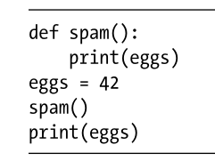
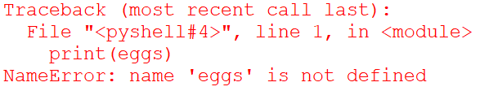

Scope
def spam():
eggs = 31337
spam()
print(eggs)
def spam():
eggs = 99
bacon()
print(eggs)
def bacon():
ham = 101
eggs = 0
spam()

Slide 40
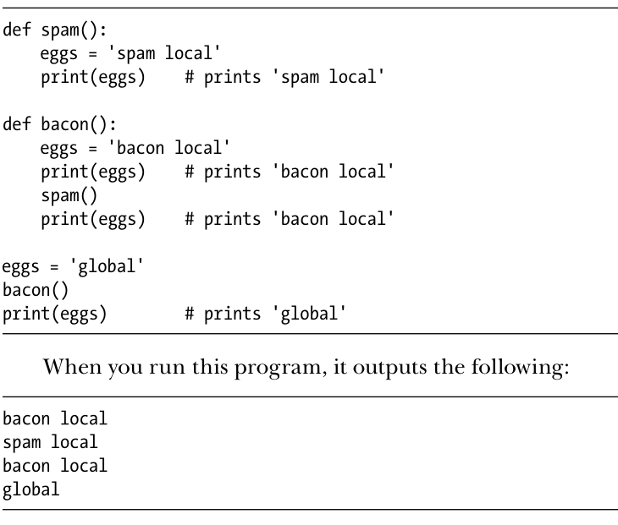
Scope

Slide 41
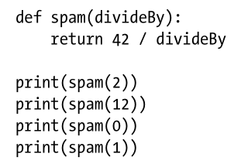
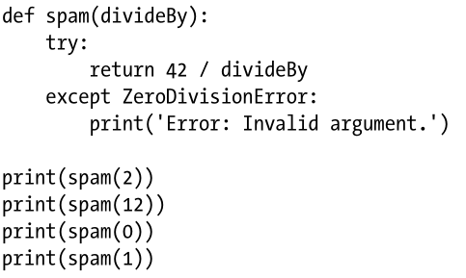
Exception Handling (Try/Except)
Make and run this program:
Then this program:

Slide 42
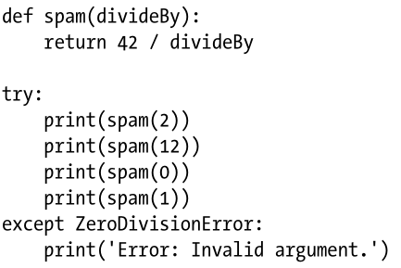
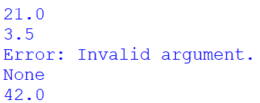
Try/Except
dog = input('Enter a number: ')
try:
dog_check = int(dog)
except:
print('That is not an integer')

Slide 43
Try/Except
If you don’t specify the kind of exception it will just catch all exceptions.
try:
something
except:
message
try:
something
except Exception:
message
<- These are equivalent ->

Slide 44
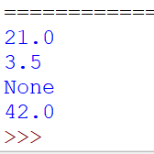
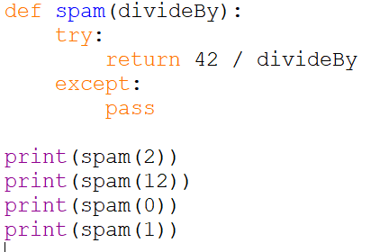
Try/Except
You have to do something with the exception but you can just say pass

Slide 45
Error Exceptions
https://docs.python.org/3/library/exceptions.html#bltin-exceptions

